Slide 1

Resilient Applications in Azure
K. Scott Allen
@OdeToCode
Notes:
Needs:
API Manager pointing to a few APIs with Swagger docs
Service Fabric application
Traffic Manager
Service Bus

Slide 2


Slide 3

High Availability
Disaster Recovery
Notes:
Needs images, ideally have some animation, too

Slide 4









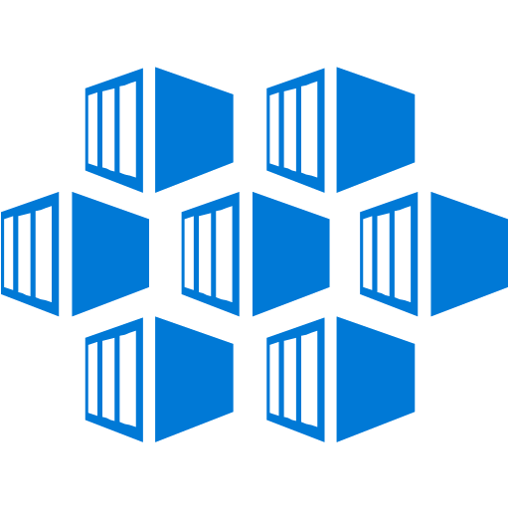






























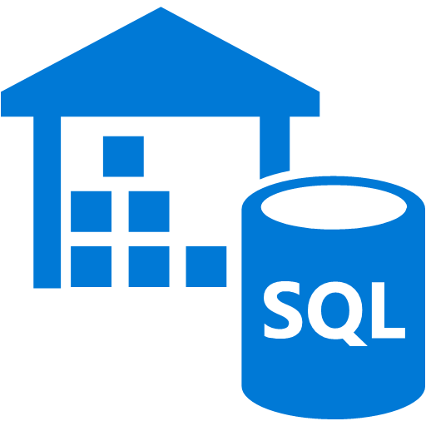






Infrastructure
Services
Platform Services
Security & Management
Compute
App Service
Analytics & loT
Compute
Cloud
Services
Windows
Web Apps
HDInsight
Portal
Service Fabric
Active
Directory
Linux
API Apps
Machine Learning
Containers
Batch
API
Management
Data Factory
Multi-Factor Authentication
Storage
Integration
Event Hubs
Automation
Mobile Apps
BLOB Storage
Storage
Queues
Key Vault
Logic Apps
Stream Analytics
Azure Files
Biztalk
Services
Notification
Hubs
Mobile
Engagement
Store/Marketplace
Premium Storage
Hybrid
Connections
VM Image Gallery
& VM Depot
Networking
Data
Virtual Network
Service Bus
Developer Services
SQL Database
Load Balancer
Media & CDN
Visual Studio
Redis Cache
DNS
Media Services
Azure SDK
DocumentDB
Express Route
Content Delivery
Network (CDN)
SQL Data
Warehouse
Team Project
Traffic Manager
Application
Insights
Search
VPN Gateway
Application Gateway
Tables

Slide 5
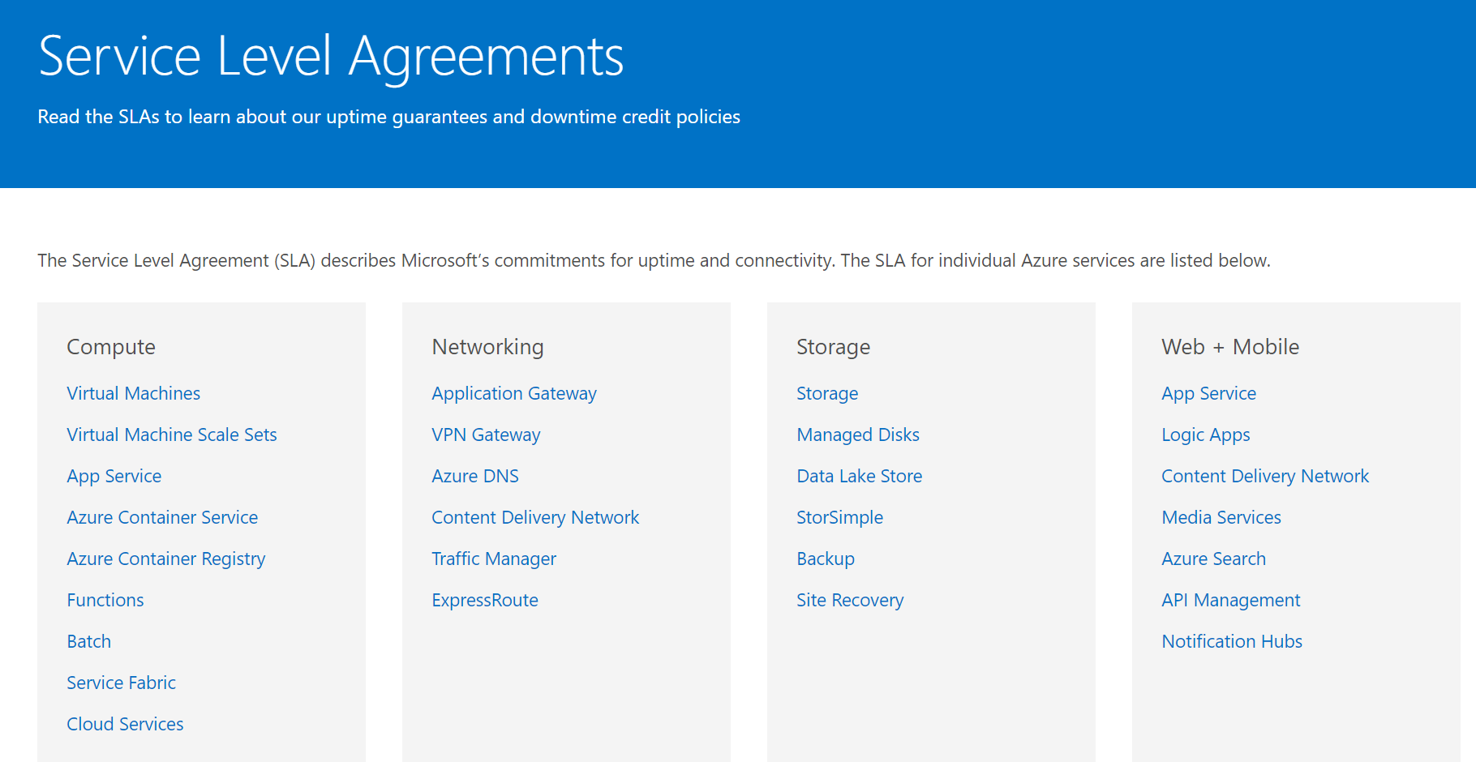

Slide 6
SLA | Downtime/week | Downtime/month | Downtime/year
99% | 1.68 hours | 7.2 hours | 3.65 days
99.9% | 10.1 minutes | 43.2 minutes | 8.76 hours
99.95% | 5 minutes | 21.6 minutes | 4.38 hours
99.99% | 1.01 minutes | 4.32 minutes | 52.56 minutes
99.999% | 6 seconds | 25.9 seconds | 5.26 minutes

Slide 7
CAP Theorem
Consistency
CP
Availability
Partition
Tolerance
AP

Slide 8
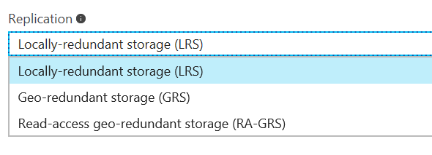

When Disaster Strikes
Blob Storage
Redundant Storage

Slide 9
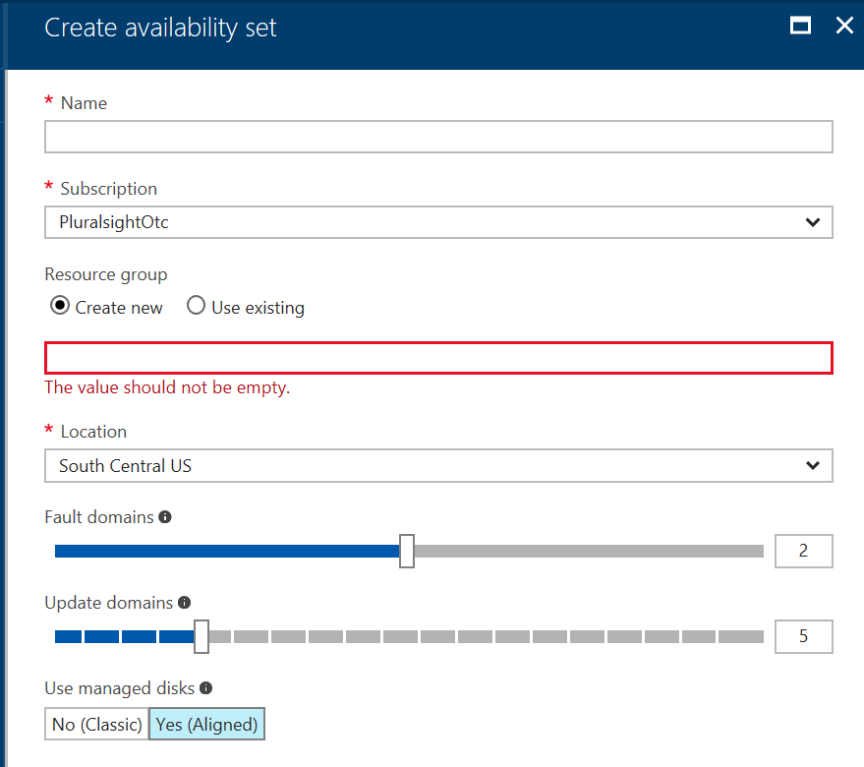

When Disaster Strikes
Blob Storage
Redundant Storage
Virtual Machines
Availability Sets

Slide 10
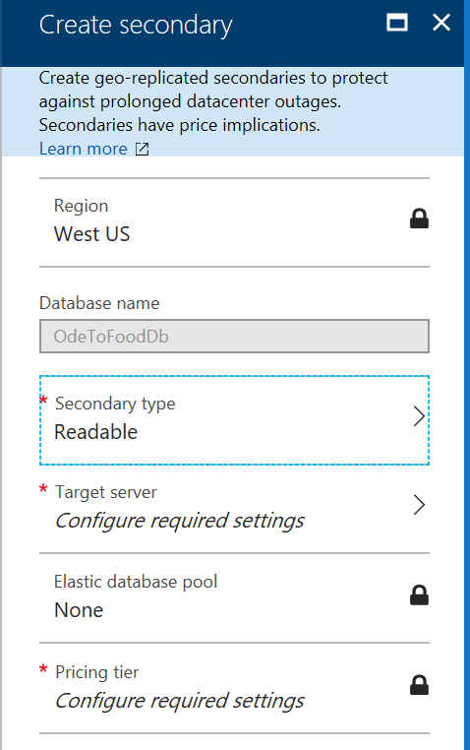
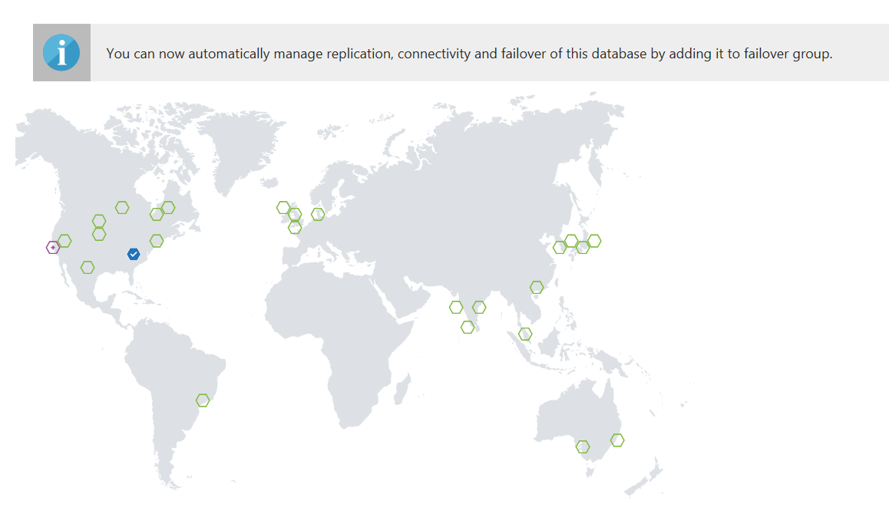

When Disaster Strikes
Blob Storage
Redundant Storage
Virtual Machines
Availability Sets
SQL
Replication
Point in Time Restore

Slide 11

When Disaster Strikes
Blob Storage
Redundant Storage
Virtual Machines
Availability Sets
SQL
Replication
Point in Time Restore
App Services
Geo Distributed

Slide 12
Load Balancing
Azure Load Balancer
Azure Application Gateway
Azure Traffic Manager

Slide 13

Resiliency in SDKs

Slide 14
Retry Logic
Service | Retry Logic
Azure Storage | In SDK
Azure SQL | In Entity Framework
Service Bus | In SDK
DocumentDB | In SDK
Azure Redis Cache | In SDK

Slide 15
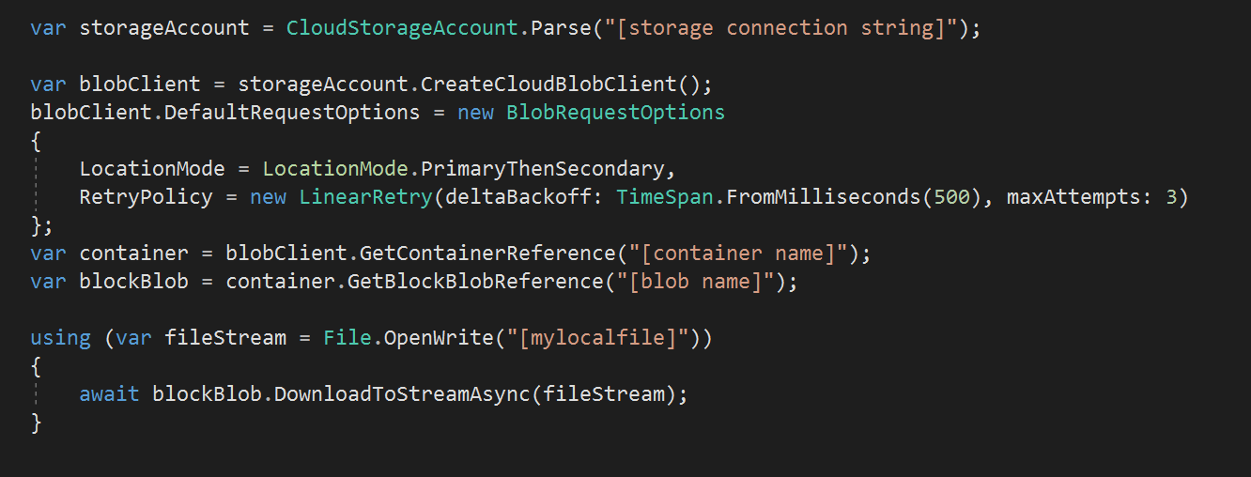
Retry Logic
Service | Retry Logic
Azure Storage | In SDK
Azure SQL | In Entity Framework
Service Bus | In SDK
DocumentDB | In SDK
Azure Redis Cache | In SDK

Slide 16
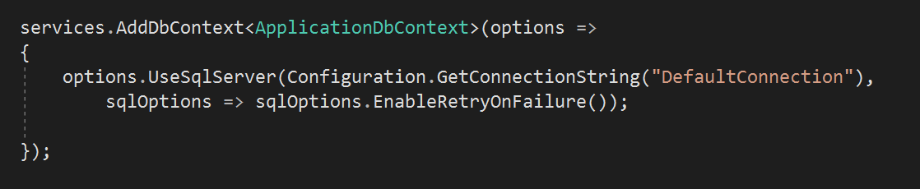
Retry Logic
Service | Retry Logic
Azure Storage | In SDK
Azure SQL | In Entity Framework
Service Bus | In SDK
DocumentDB | In SDK
Azure Redis Cache | In SDK

Slide 17


Application Patterns

Slide 18
CQRS

Slide 19
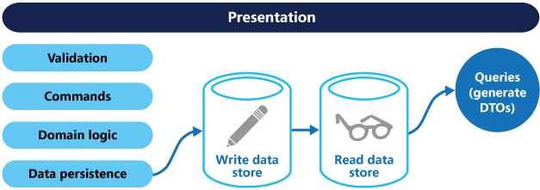
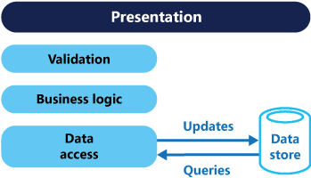
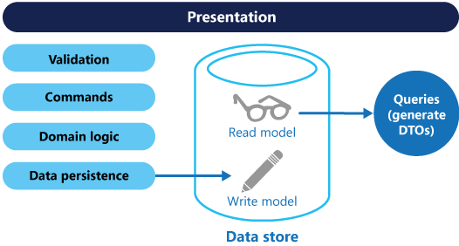
CQRS

Slide 20
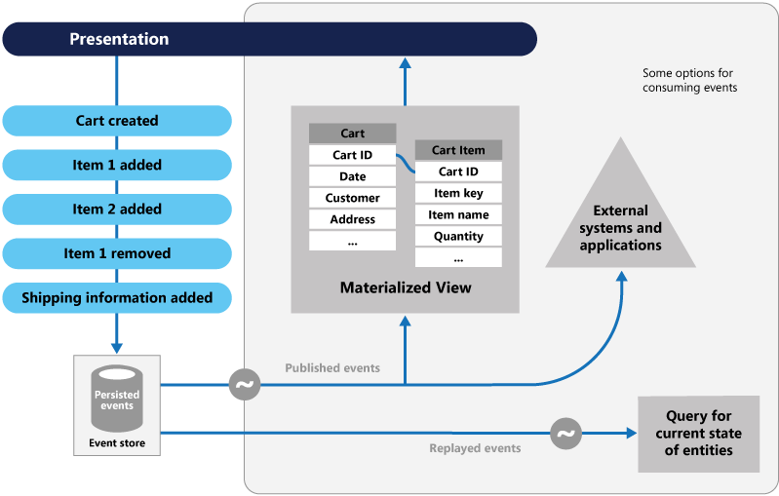
Event Sourcing

Slide 21
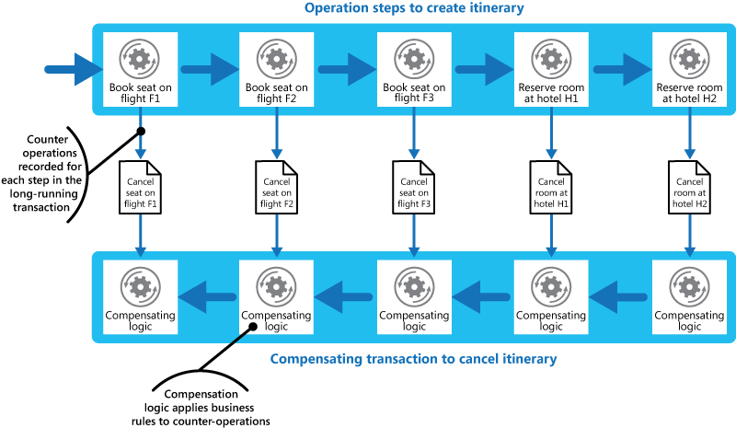
Compensating Transactions

Slide 22
Partitioning

Slide 23

Partitioning
Orders
Orders
Orders
Invoices
A | B | C | D | E
A | B | C | D | E
A | B | C
A | B | C
A | D
B | C | E
Horizontal
Partitioning
Functional
Partitioning
Vertical
Partitioning

Slide 24
Azure SQL Sharding
Map
Tenant D
Tenant A
Tenant B
Tenant C

Slide 25
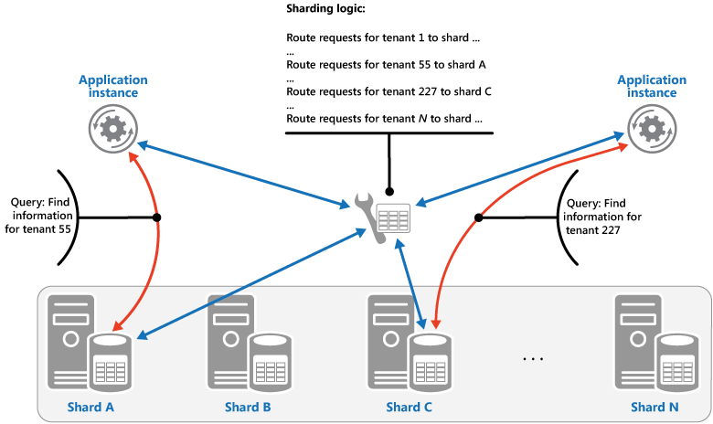
Lookup Partitions

Slide 26
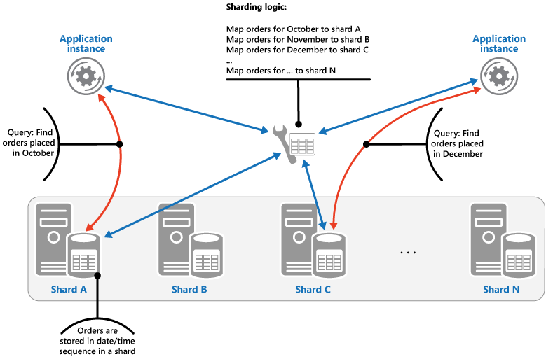
Range Partitions

Slide 27
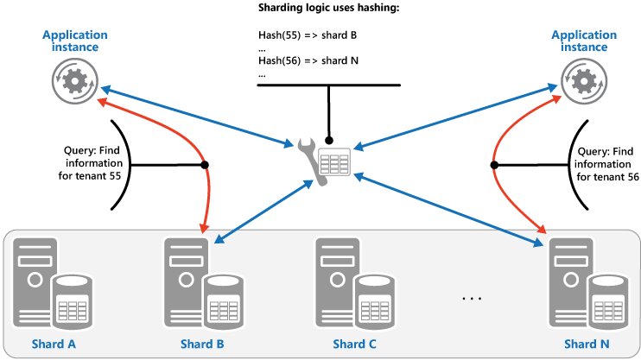
Hash Partitions

Slide 28
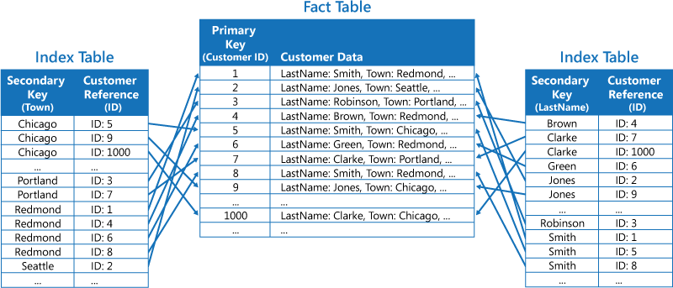
Index Table

Slide 29
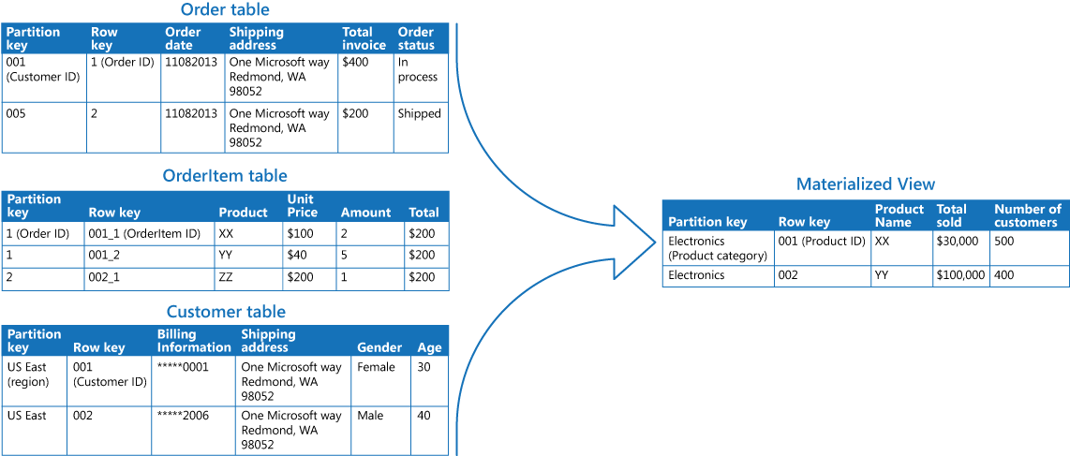
Materialized View

Slide 30
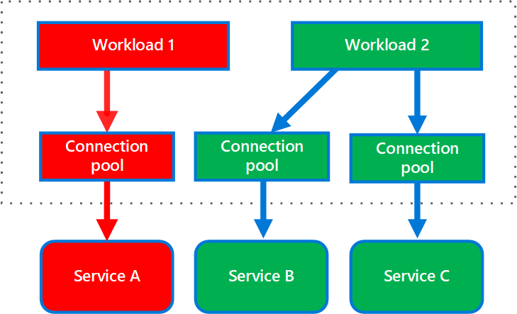
Bulkhead

Slide 31
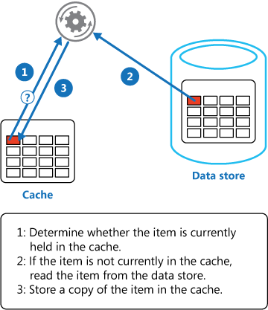
Cache Aside

Slide 32


Automation & Deployment

Slide 33


Testing

Slide 34

Monitoring

Slide 35





Traffic Manager
Service Bus Queues
Azure
Functions
Customers
CDN
Blob Storage
App Service
Redis Cache
API Gateway
Azure SQL
Application
Insights

Slide 36
The End
K. Scott Allen
scott@OdeToCode.com
@OdeToCode

